Slide 1

LAB - 2 FOURIER ANALYSIS OF A SQUARE WAVE
Goals: Analyze the spectrum of a sin wave and square wave using Matlab and Multisim.

Slide 2
SOFTWARE REQUIRED: COMPONENTS:
MATLAB
NI MULTISIM
MATLAB: MATLAB Code Multisim: 1) Function generator 2) Oscilloscope 3) Spectrum analyzer 4) Ground

Slide 3
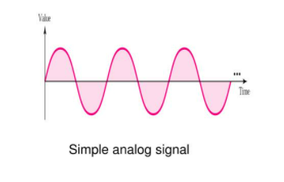
What is a signal ?
A signal is a function that represents a physical parameter or quantity.
It contains information about the nature or behavior of the physical process

Slide 4
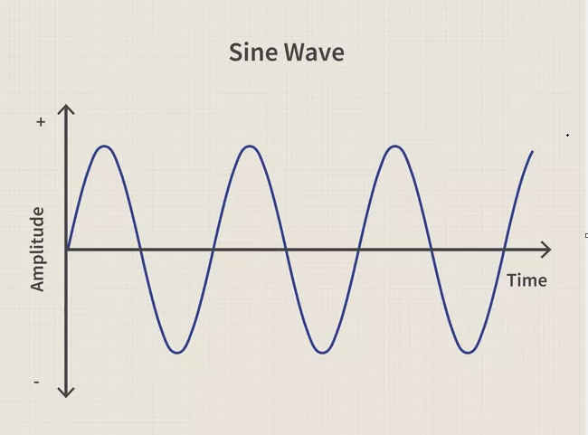
What is Sine Wave ?
A waveform that represents periodic oscillations in which the amplitude of displacement at each point is proportional to the sine of the phase angle of the displacement.
A sine wave is a continuous wave.
X(t) = A sin (W₀t + ϕ)
A- Amplitude
W₀ - Fundamental Freq
ϕ - Phase Shift

Slide 5
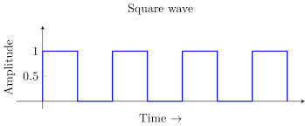
What is a Square Wave ?
A square wave is a non-sinusoidal periodic waveform in which the amplitude alternates of a steady frequency between fixed minimum and maximum values.
A non-sinusoidal waveform, commonly encountered in electronics and signal processing, that alternates regularly and instantaneously between two levels.

Slide 6
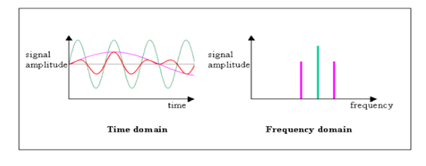
What is Frequency Domain ?
The Frequency Domain refers to the analytic space in which mathematical functions or signals are conveyed in terms of frequency, rather than time.
For example, where a time-domain graph may display changes over time, a frequency-domain graph displays how much of the signal is present among each given frequency band.
The frequency-domain representation of a signal is known as the "spectrum" of frequency components.

Slide 7
WHAT IS A BANDWIDTH ?
Bandwidth is measured as the amount of data that can be transferred from one point to another within a network in a specific amount of time. (OR) Data transmitted per unit time is defined as bandwidth.
If Bandwidth increases, then speed of the connection also increases.
If bandwidth increases, the range decreases.
It is measured in Herz.

Slide 8
What is Data Rate ?
The data rate is a term to denote the transmission speed, or the number of bits per second transferred.
Data rate may also be written in baud rate (e.g., the number of signal units per second).
Data Rate = 1/T bps
Example: 1) internet connection
2) uploading or downloading data
Example : If a person was only one visiting a web address, then the page load instantly, when thousands of people visiting same web address then the rate of incoming data must be optimized for it

Slide 9
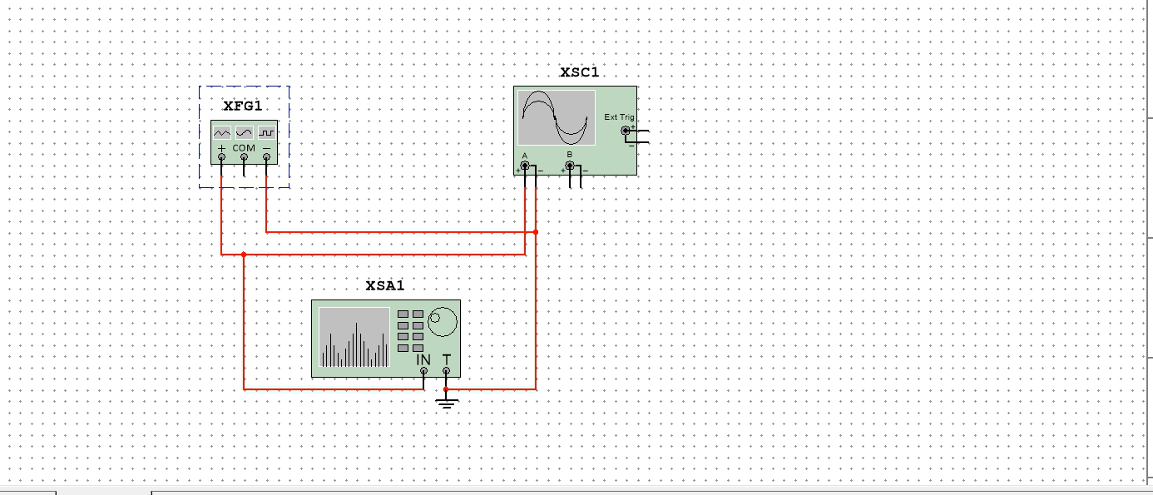
CIRCUIT DIAGRAM

